Slide 1
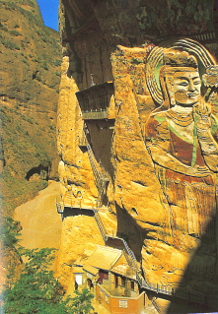
Buddhism

Slide 2
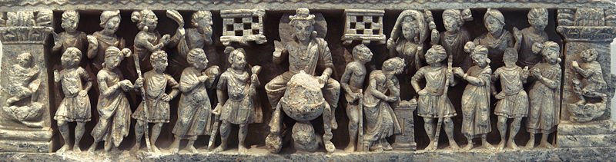
Siddhārtha Gautama (ca. 563-483 BC)
Sakyamuni or “sage of the Sakya tribe” (of Northern India) is the professed founder of Buddhism, although accounts of his life not written down until centuries after his death.

Slide 3
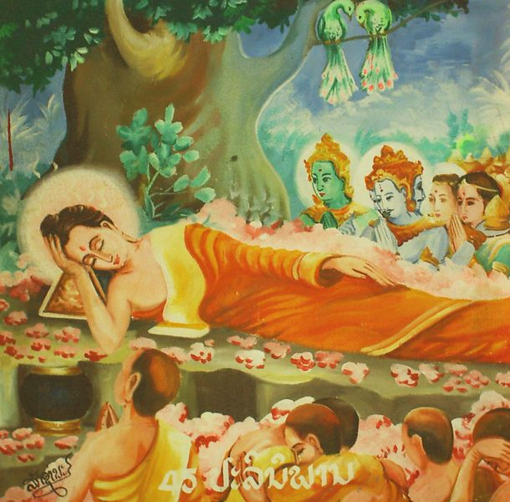
Enlightenment of the Buddha
Born a prince brought up in seclusion, but later shocked by poverty into religious understanding.
On three successive outings he met an old man, a sick man, and a dead man, signifying for him the fate of humankind.
Initially practiced asceticism, which nearly killed him.
In about 530 BCE his enlightenment under a bodhi tree caused the earth to sway and blossoms to rain down from the heavens.

Slide 4
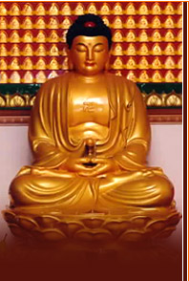
The three “Jewels” of Buddhism
The Buddha himself
Dharma (teachings)
Sangha (community of believers)

Slide 5
The Four Noble Truths & the Eight-fold Path
First Noble Truth: Life is suffering; death is not the answer; for every action there is a moral reaction (karma); the goal is not to be reborn, but to attain Nirvana and vanish (to be extinguished!).
Second Noble Truth: The cause of human suffering is desire.
Third Noble Truth: To stop suffering, desire must be stopped by living an ethical life and following the last of the four truths:
Fourth Noble Truth: the Eight-fold Path: right views, right intention, right speech, right action, right livelihood, right effort, right mindfulness, and right concentration.

Slide 6
Major Schools of Buddhism
Theravada (Lesser Vehicle): predominate in Sri Lanka and Southeast Asia; stronger focus on good works in the community. Nirvana reached (as an arahat) by ones' own efforts.
Mahayana (Greater Vehicle): in East Asia; Strong focus on self-cultivation and faith. Goal was to become a bodhisattva by postponing one’s own enlightenment to help others.

Slide 7
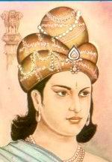
Reign of King Asoka (c. 272 BCE-232 BCE)
Third monarch of the Indian Mauryan dynasty (321 to 185 BCE), who converted to Buddhism after a series of wars of conquest.
Abolished warfare, initiated humanitarian works throughout his empire and promulgated his edicts, which established the moral precepts of Buddhism.
Buddhism entered Gandhara during the Asoka’s reign and thereby became known to communities along the Silk Road.

Slide 8

Cakravartin
Cakravartin (Pali, cakkavatti) or “Wheel turning Monarch” became a position of supreme political power in the Buddhist world.

Slide 9
Buddhism’s Arrival and Adaptation in China
The nomadic Northern Wei (386-534) rulers of northern China were great patrons of Buddhism.
The Chinese Goddess of Compassion Guanyin, while still in India, was the male bodhisattva Avalokitesvara, who was famed for his mercy.
The fierce Indian bodhisattva Maitreya became the Mi lo Buddha (or “Laughing Buddha”).

Slide 10
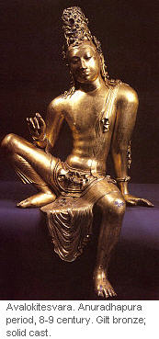
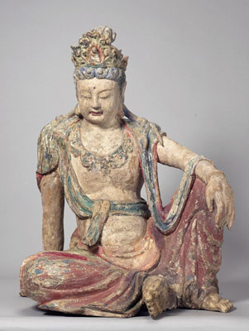
Avalokitesvara to Guanyin
Images Sources: Lankalibrary Forum, “Bodhisattva Avalokitesvara From Veheragala ” (www.lankalibrary.com/images/avalokitesvara.jpg ) and Silk Roads Gallery “Figure of Guanyin in Lalitsana ” at http://www.silkroadsgallery.com/enlargement/china_east_asia/china_east_asia_16491.html

Slide 11
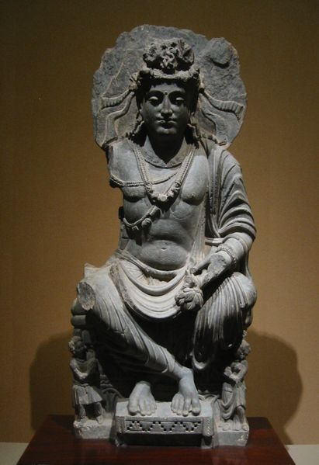
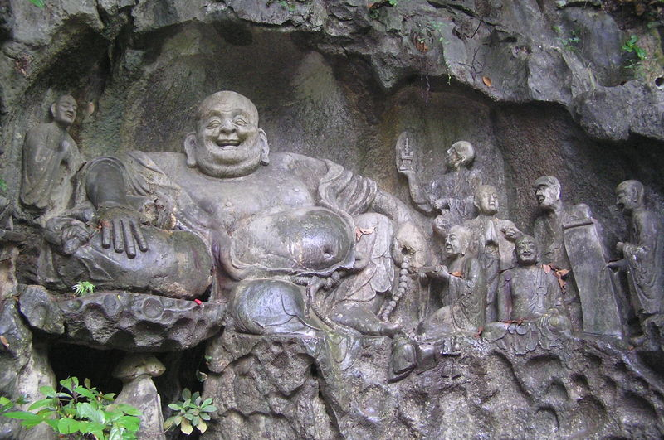
Maitreya to the Mi lo Buddha
Image sources: Maitreya Buddha: Wiki Commns photo “Seated Maitreya. 2nd century Gandhara. Tokyo National Museum. Personal photograph 2005” at http://commons.wikimedia.org/wiki/Image:MaitreyaSeated.JPG. Mi lo Buddha: Miguel A. Monjas, “Carving of Maitreya (future Buddha) and disciples in Feilai Feng (Hangzhou, China)” at http://commons.wikimedia.org/wiki/Image:Maitreya_and_discilples_carving_in_Feilai_Feng_Caves.jpg

Slide 12
Buddhism’s Spread and Adaptation Throughout East Asia
Buddhism was introduced in Japan in 550 by a Korean delegation from the Paekche Kingdom. Prince Shotoku (573-621) would call for the establishment of Buddhism as the state religion when he became Regent at the Yamato court in 593.
In 580 Buddhism (Zen) begins to spread more widely in Viet Nam with the arrival of the Indian missionary Vinitaruci (fl. 6th century).

Slide 13
Problems: Buddhism vs. Confucianism
Celibacy seen as a supremely unfilial act by Confucians.
Buddhist monks shave their heads and scar their scalps; against Confucian notion of protecting the body as parent's gift.
Buddhist monks have no regard for human body, no regard for anyone, including emperor.

